Slide 1

MICRO CREDIT DEFAULTER PROJECT

Slide 2
Business Problem
A client in Indonesian Telecom Industry is collaborating with an MFI (Microfinance Institution) to provide micro-credit on mobile balances to be paid back in 5 days. The Consumer is believed to be defaulter if he deviates from the path of paying back the loaned amount within the time duration of 5 days.
In order to improve the selection of customers for the credit, the client wants some predictions that could help them in further investment and improvement in selection of customers.
MOTIVATION FOR THE PROJECT
Based on data provided from our client database, customer’s repayment of loan is assessed based on different factors. By building the model, we can assess which customers are highly likely to repay the loan, thereby it will be useful for those needy people who will repay the loan and also prevent the loss to the customer by avoiding loans to the defaulters.

Slide 3
ANALYTICAL PROBLEM FRAMING
For the given project, based on various parameters we need to predict whether the customer is a defaulter or not.
This is a classification problem. There are wide varieties of classification models like decision trees, random forests, nearest neighbor, Logistic Regression.
The data has been provided by client in a comma separated values(.csv) format.

Slide 4
Exploratory Data Analysis
There are 209593 Row 36 columns in Data Frame.
Data cleaning is a part of pre-processing technique where missing values will be dealt.
Msisdn column will be dropped as it contains phone number of customer and it wont impact the precitions.
Pcircle column will be dropped as it has same entry in all the columns.
Pdate column will be splitted into 3 separate columns named year month and date.
The year column has only 1 value(i.e 2016)in all rows so deleting the year column

Slide 5
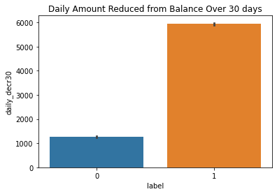
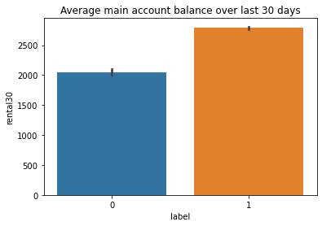
Data Visualizations:
Daily Amount Reduced from Balance Over 30 days
Average main account balance over last 30 days

Slide 6
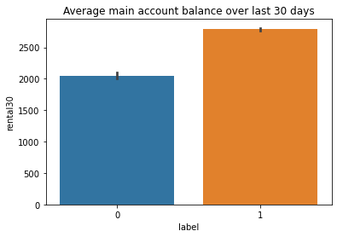
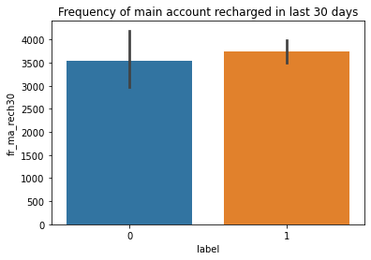

Slide 7
After visualizing data with the help of different plots we came across few observations
We can note that there is less data about defaulters and more about those who did repay their loan.
Hence can say that the data is imbalanced.
With increase in Age on Network, defaulting rate is higher
There is huge imbalance in the data collected,
When compared to the imbalances, we can note that there is less difference between loan default and repayment. Hence can say that with the increase in Average Main balance, there is a probability of defaulting.
Defaulters have max average balance of 2000,repayers has an average main balance over 2500

Slide 8
Defaulters recharged Main account max number between 1 and 2 times.
Whereas re-payers recharged for 4 plus times.
With increase in frequency of Recharge in last 30 days, equal probabilities of defaulting and repayment. Even though there is less data about defaulting, there is high chance of defaulting with increased recharge frequency.
The defaulters has max limit ranging between 2000 and 3000 of Total recharge amount.
On an average the defaulters has recharged for a max of 1000 Indonesian rupiah.
Defaulters has a median Main account recharge amount ranging between 4000 and 5000.
With increase in Median of Main balance recharge, probability of defaulting is very high.
Defaulters has recharged the data account for a maximum of 200 to 250 times.

Slide 9
With increase in No. of times data accounts recharge, probability of defaulting is high.
With increase in frequency of recharging data account, higher chances of defaulting.
Defaulters has taken between 1 to 1.5 no. of loans.
As practically there will be no 1.5 loan, considering only 1 loan.
Those who repaid had taken max of 3 loans.
Total Amount of loans took by Defaulters varies between (7.5 to 10).
Re-payers has took 20 loans which tends to be the max limit.
A user can take Maximum of 7 loans in 30 days.
Defaulters took 6 loans whereas re-payers took 7 loans.
Can say that there not a much difference in loans took by both defaulters and Re-payers.
Median of loan Amount by defaulters is 0.03 whereas Re-payers took max of median amount which is 0.06

Slide 10
A potential defaulter might repay in 2 days.
Re-payers took average of 3.5 days.
The defaulters has spent a little above 1000
Re-payers has spent 7000.
Defaulters average=2000 to 2500.
Re-payers average= 3500.
Defaulters recharged for 2 times.
Re-payers recharged for 7 times.
Defaulter’s frequency is 5.
Re-payers frequency is 8.
Defaulters recharge amount varies from 2000 to 4000.
Re-payers recharged for 14000.
Defaulter’s median-1250.

Slide 11
Re-payers median -2000.
In terms of No. of times data account recharged, both defaulters and re-payers has approximately equal no. of recharges.
With increase in frequency of Data account recharge in 90 days, defaulting rate is high.
Defaulters took max of 15 loans
Re-payers took max of 20 loans
Defaulters took max of 10 loans.
Re-payers took 25 max of loans.
In terms of maximum loan amount, both defaulters and re-payers max limit is approximately same.
Defaulters took max. median of 0.03 loan amount
Re-payers took max. median of 0.05 loan amount
Average pay back time of potential defaulter in 90 days is 3 days.
Average pay back time of re-payer in 90 days is greater than 4 days.

Slide 12
Models Development
The data set is imbalanced since it has large no. of records which contains data about those repaid the loan and less no. of records of those who defaulted loan. This might result in biased predictions. So, used imblearn library to reduce the imbalances. The imblearn library provides different approaches one is Random under sampling. In context of this problem, Random under Sampling reduces the number of records of those who paid the loan. To be precise, random under sampling deletes data from the majority class such that there will be equal number .of samples of both the classes. Hence reduces the bias.
Outlier removal: Mostly outliers are removed by either Z score or IQR (Inter Quartile Range).Tried both these approaches first but, the data loss is high in both these approaches. It has been mentioned in guidelines that the data loss should not exceed 7%.So applied capping technique which is also called as Winsorizing.

Slide 13
Algorithms
I have tried different classification algorithms to check which algorithm performs best.
I did cross validation before fitting a model to avoid over fitting and cross validation also determines a models ability to predict on new data.
List of algorithms used:
Logistic Regression
Decision Tree Classifier
KNeighborsClassifier
RandomForestClassifier
AdaboostClassifier
BaggingClassifier
GradientBoostingClassifier

Slide 14
Choosing the Algorithm
The algorithms are evaluated on different criteria like accuracy , precision, recall
I have chosen Adaboost classifier because there is less difference between train and test accuracies which indicates there will be no over or under fittings.
Hyper Parameter Tuning
Hyper parameter tuning is used to increase the performance of the algorithm
Hyper parameter tuning tends to reduce over fitting as well.

Slide 15
CONCLUSION
The model we built predicts whether the customer defaults or not with an accuracy of 81.8%.
The defaulting rate is higher in old customers. Defaulters recharge for the main account less Number of times but does recharge for data account more Number of times.
Re payers recharge the main account more Number of times when compared to defaulters.
This data set contains data of the year 2016 belonging to PSW telecom circle.
If we get data of other years along with other telecom companies there will be scope for future work on this project.

Slide 16
Submitted by :- Ankit soran
Thank you

